Slide 1
Boston Housing Prices: A Case Study
Anish Chakrabarty (171024)
Rahul Singh (171111)
Soumyadip Fadikar (171154)
Sourav Nandi (171157)

Slide 2
Introduction
Our study is based on a dataset containing information collected by the U.S. census service (1978) concerning houses from various suburbs in Boston, Massachusetts. It consists of 506 observations on 14 variables.

Slide 3
Data Description
Response:
medv(y): median value of owner-occupied homes in $1000s.)
Regressors:
crim(x₁): per capita crime rate by town
zn(x₂): proportion of residential land zoned for lots over 25,000 sq.ft

Slide 4
indus(x₃)= proportion of non-retail business acres per town.
chas(x₄)= Charles River dummy variable (= 1 if tract bounds river; 0 otherwise).
nox(x₅)= nitrogen oxides concentration (parts per 10 million).
rm(x₆) =average number of rooms per dwelling.
age(x₇) =proportion of owner-occupied units built prior to 1940.
dis(x₈) =weighted mean of distances to five Boston employment centres.
rad(x₉)=index of accessibility to radial highways.

Slide 5
tax(x₁₀)=full-value property-tax rate per \$10,000.
ptratio(x₁₁)=pupil-teacher ratio by town.
black(x₁₂)=1000(Bk - 0.63)^2 where Bk is the proportion of African-Americans by town.
lstat(x₁₃)=lower status of the population (percent).

Slide 6
Motivation
The goal of this analysis is to implement a working regression model that predicts the housing prices in the city of Boston based on the values of other variables.

Slide 7
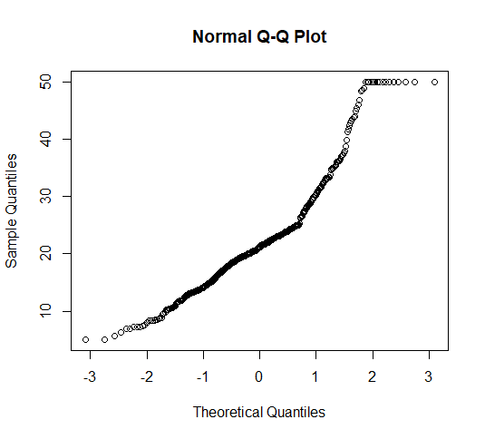
Checking of Normality assumption

Slide 8
Data cleaning
We observe that there is possible censoring in the data. The maximum of medv is 50 and this value is reported for 16 observations. This is causing a heavy right tail and thus the deviation from normality is appearing to be visually significant. We remove these observations from the data set and fit a model on the remaining 490 observations.

Slide 9
Analysis
Our initial regression model,
y_{i}=β₀ +β₁x_{i1} +β₂x_{i2}+………..+β₁₂x_{i12} +β₁₃x_{i13} +ε_{i} , for i=1,2,....,n=490
where β_{i}’s represent the linear regression coefficient corresponding to the ith regressor.
Fitted the model using Method of least squares.
Adjusted R-square: 0.792

Slide 10

Box-Cox transformation
The visual deviation from normality appears significant and therefore we apply the one parameter Box-Cox Transformation which is given by,
The obtained value of λ=0.4

Slide 11
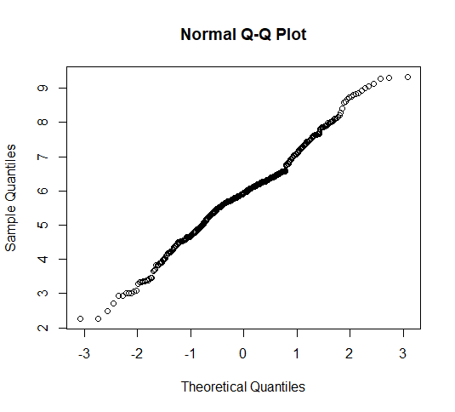
Q-Q plot after Box-Cox transformation yields in,

Slide 12
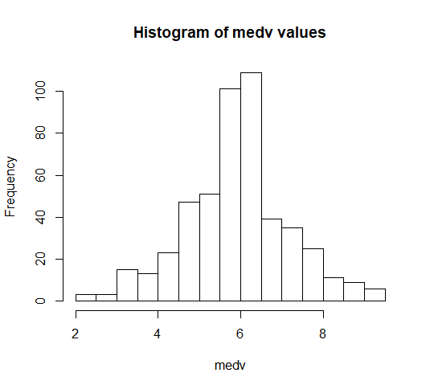
The histogram of medv is obtained as,
This histogram further justifies that the observed medv values can considered to have been originated from a Normal distribution.

Slide 13
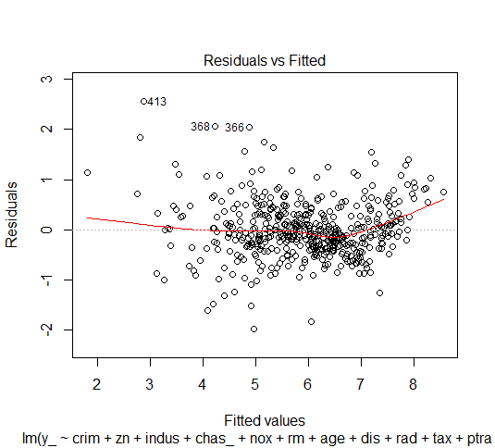
By plotting residuals against predicted values we get,
Which shows no systematic behaviour. Hence, we discard the possibility of presence of heteroscedasticity.

Slide 14
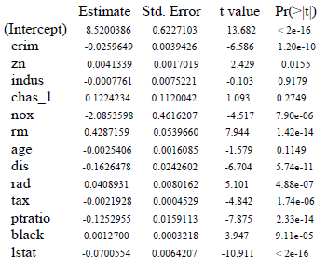
Regression outputs for coefficients are given by,
From this primary model we observe that the hypothesis H_{0j}: β_{j}=0 vs. H_{1j}: Not H_{oj} is getting accepted for the regressors indus, chas and age at 5% level of significance.

Slide 15
Influential point detection
Now, we calculate Cook’s distance to check for presence of outliers. The form of Cook’s D statistics is given by,
Di=((𝑦𝑖−𝑦𝑖̂)∗ℎ𝑖𝑖 )/(p∗MSE∗(1−ℎ𝑖𝑖 )^2)

Slide 16
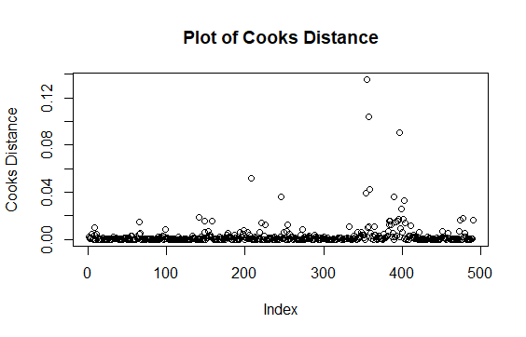
We observe that there are no outliers in the dataset as there are no Di’s greater than 1.

Slide 17
Checking for Multicollinearity
Now, we obtain the Variance Inflation factors (VIF),
From the VIF values it is observed that the variables rad and tax are involved in multicollinearity because the VIF values of these variables is greater than 5.
crim | zn | indus | chas | nox | rm | age | dis | rad | tax | ptratio | black | lstat
1.79 | 2.29 | 3.99 | 1.06 | 4.40 | 1.80 | 3.11 | 3.97 | 7.36 | 8.79 | 1.71 | 1.34 | 3.13

Slide 18
We also observe that the correlation coefficient of rad and tax=0.908
We drop the variable tax because the VIF value of tax is observed to greater than that of rad.
VIF values of the regressors after dropping the tax variable are obtained as,
crim | zn | indus | chas | nox | rm | age | dis | rad | ptratio | black | lstat
1.79 | 2.17 | 3.30 | 1.04 | 4.37 | 1.87 | 3.11 | 3.97 | 2.85 | 1.70 | 1.34 | 3.13

Slide 19
Variable Selection
Now, by Backward Elimination process we discard the following regressors,
Step 1: zn
Step 2: chas
Step 3: age
Final Regressors: crim, indus, nox, rm, dis, rad, ptratio, black, lstat

Slide 20
The final model is obtained as,
Y_{i}=8.35 -0.03 x_{i1(crim)} -0.02x_{i3(indus)}-2.46x_{i5(nox)} +0.44x_{i6(rm)} -0.14x_{i8(dis)} +0.01x_{i9(rad)} -0.14x_{i11(ptratio)} +0.001x_{i12(black)} -0.07x_{i13(lstat)} for i=1,2,....,n=490
Model outputs:
Multiple R-squared: 0.7842
Adjusted R-squared: 0.7802
Residual standard error: 0.5836 with df = 480
F-statistic: 193.9 with df 9 and 480

Slide 21
Conclusion
From the model, the first thing that can be interpreted is that crime rate (crim) is negatively correlated with house price.
Prices decline at areas with a high concentration of Nitrogen Oxides (nox) in air. It is expected that people would try to live under pollution-free conditions.

Slide 22
The average number of rooms (rm) is positively correlated with house price.
House prices fall as one moves away from employment centres (dis).
The more is the accessibility to radial highways (rad), the higher are the prices of residential plots.
House prices are higher in areas with lower pupil-teacher ratios (ptratio).

Slide 23
Thank you

